Slide 1
OPA Newsletters & The Data That Informs Them

Slide 2
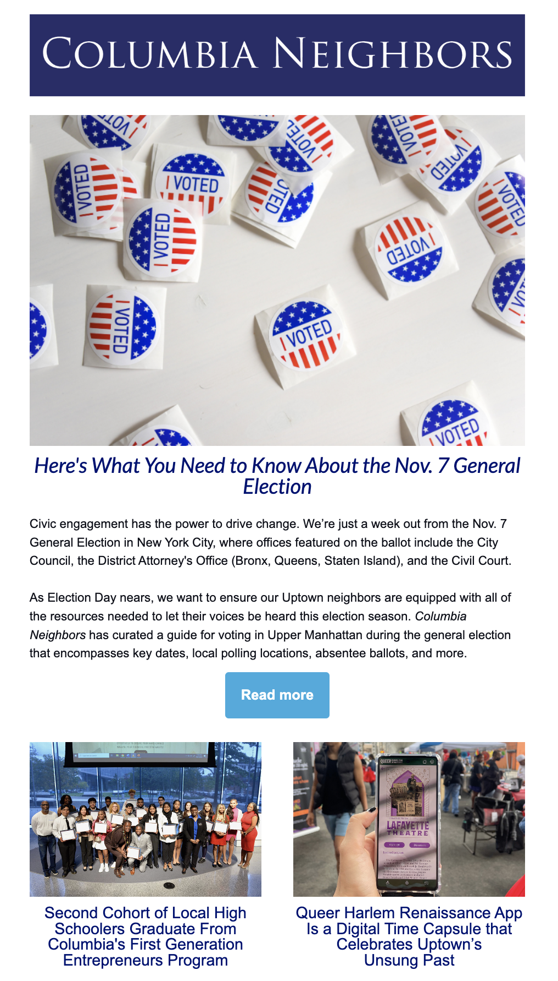
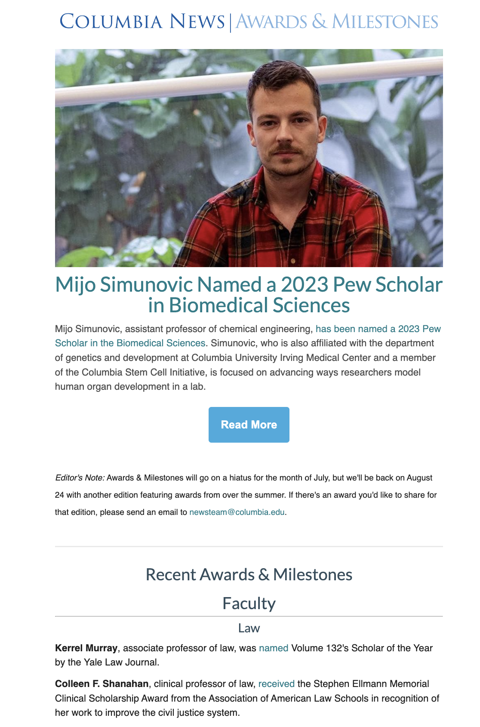
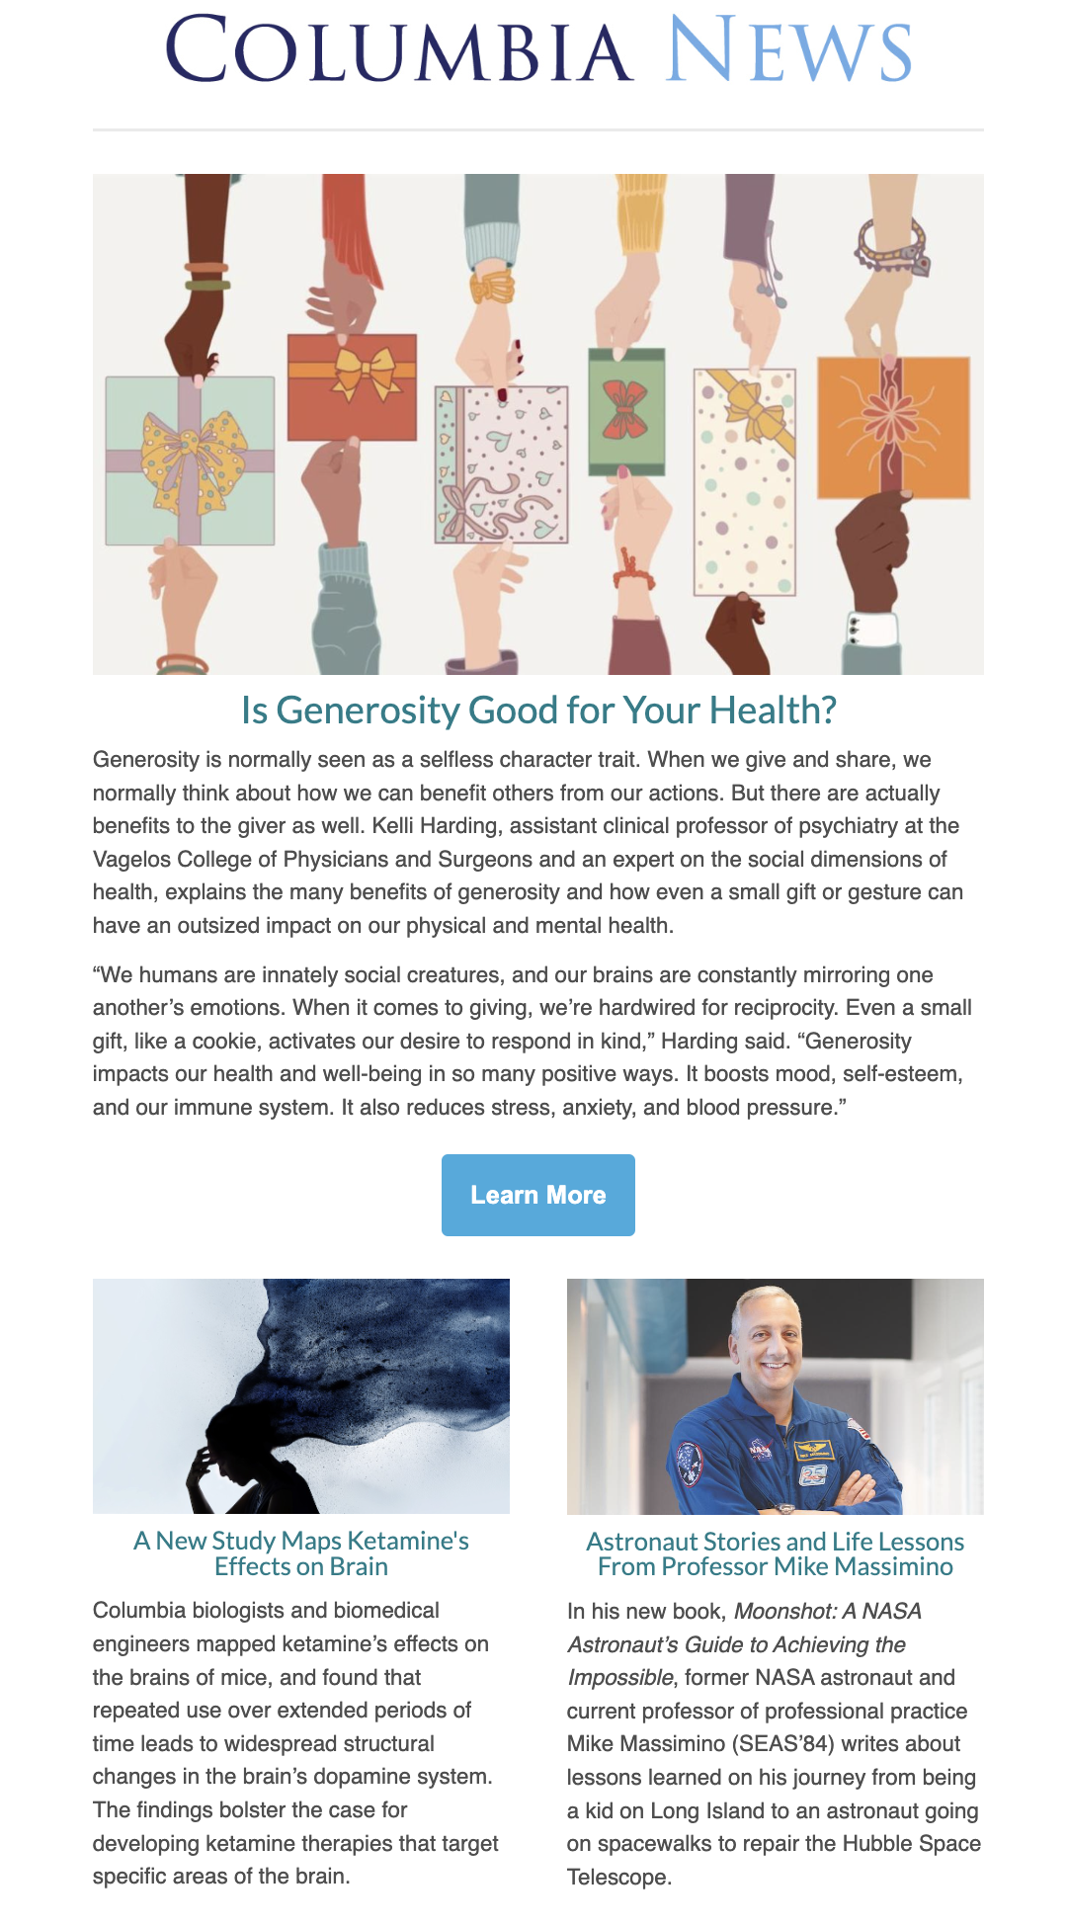
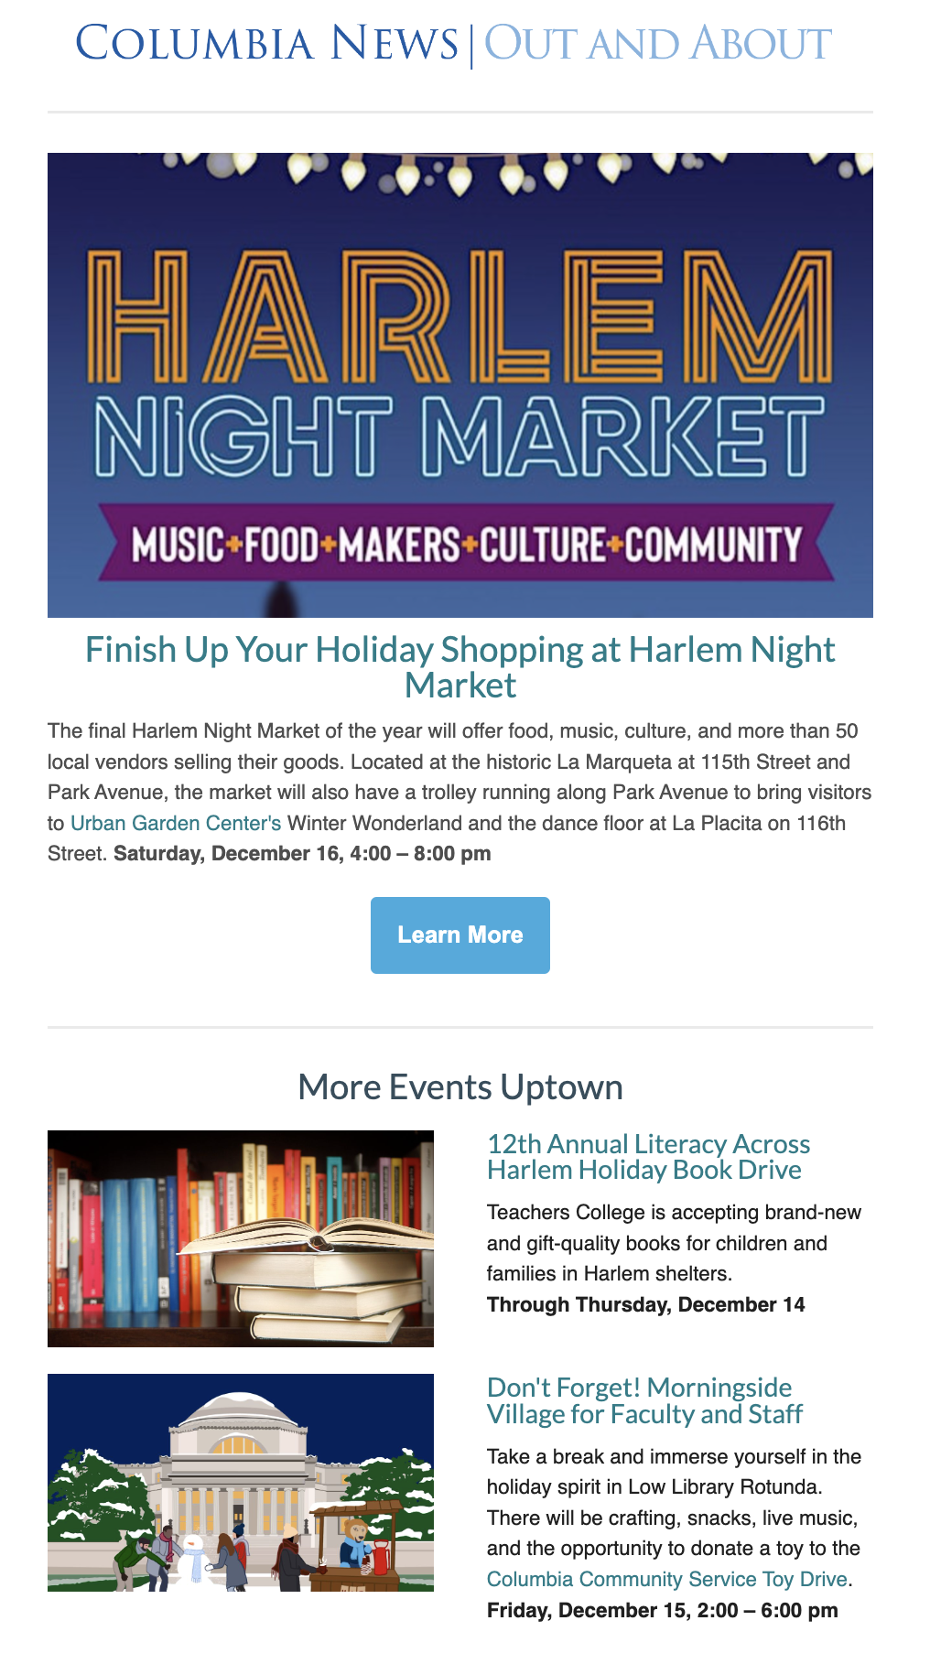
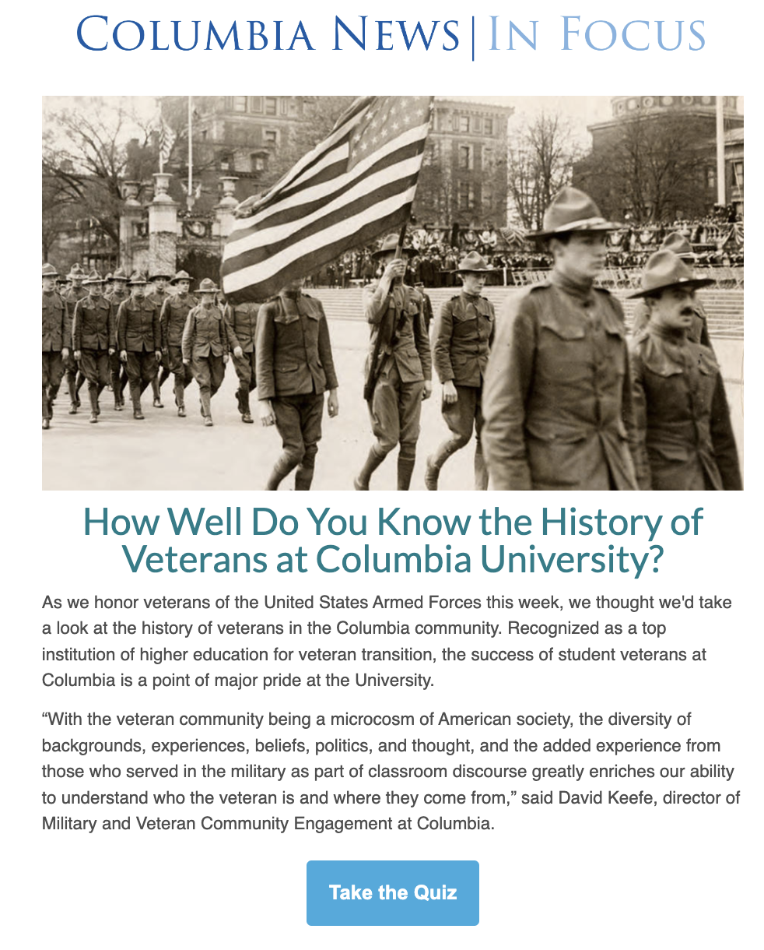
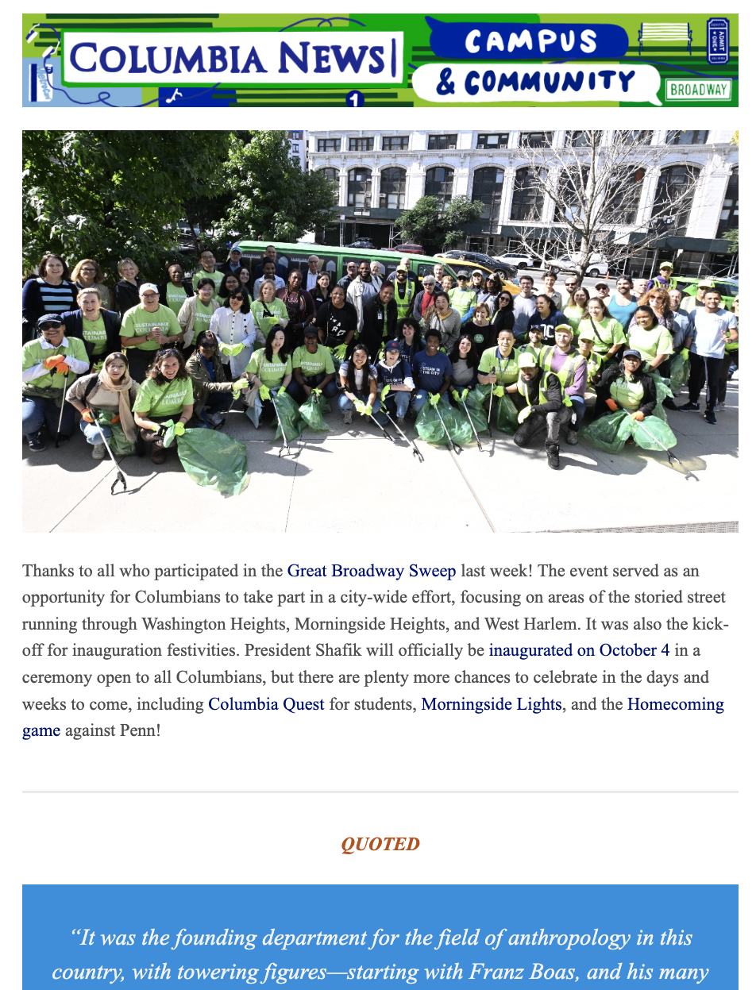
MONDAY
WEDNESDAY
THURSDAY
FRIDAY
The Office of Public Affairs releases seven external-facing newsletters with varying audiences five times a week.
Notes:
Enews Ecosystem that highlights our faculty, staff, and students, and engages with our local community.
We offer 7 editions, five times a week. The editions include:
A thematic Spotlight (Monday)
A Neighbors edition where we highlight news for and about the local community (Wednesday morning)
Events, and our newest edition, Campus a Community, a lighthearted roundup of news and profiles from across CU (Wednesday afternoon)
Alternate Thursdays: In Focus, which is essentially a digital postcard on one key story for the week.
Awards & Milestones, once a month
On Friday, we have our original Enews, highlights from across CU
It’s a modular system that can adapt to any content or communications priority.
This email system is nimble enough for us to quickly launch branded emails. Which we did during the pandemic, when we produced editions for Reopening news, and one specifically launched to give our international students a sense of community. During Union negotiations, we even went off-brand to help the Provost send customized updates.
It has the kind of content flexibility that you often only have on social media and it’s driven, in part, by analytics.

Slide 3
What We’ve Learned About What Readers Want
We track monthly and yearly quantitative analytics data on Columbia News & Columbia Neighbors products with an eye to newsletter performance and referrals…
TOP CONTENT PERFORMANCE
HEADLINE PERFORMANCE
DEEP ENGAGEMENT (TIME)
Research
Campus history/people/ photos
Commencement
Institutional news
“How”/”Why”/ ”What
“Meet”
“Here’s”
“New”
“Secret”
“Story Behind”
#s
Questions
Stories explaining phenomenon (keyword)
Stories inviting or reflecting participation
Stories about Columbian involvement you didn’t know

Slide 4
What We’ve Learned About What Readers Want
…We also qualitatively survey our audiences regularly
WHAT THEY REMEMBER
Fun campus updates
Neighborhood updates/guides
People you should know profiles
Institutional updates
TOPICS THEY ENJOY
Campus News & Events
Arts & Humanities
Current Events
STEM/Research
Neighborhood News
WHAT THEY WANT MORE OF
Q&A/Interviews
People Profiles
Photo Essays
“Opinion Pieces” (students)
Multimedia Videos/Quizzes
WHAT THEY WANT TO KNOW
Columbia History
Student Stories (working on big things)
Alumni Connections to Current Things
How Columbia Works
Faculty/Staff Career Path
“Quirky”Characters
Under-recognized Department Stories
Neighborhood history/then & now
Behind-The-Scenes
Notes:
QUALITATIVE

Slide 5
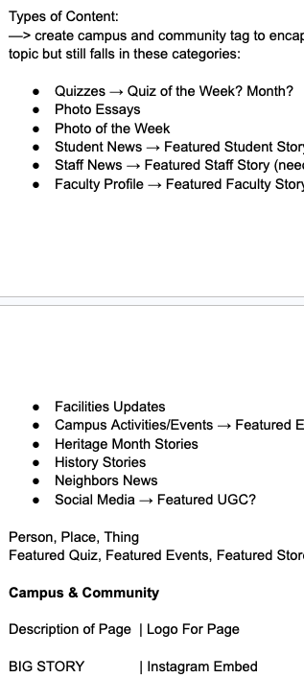
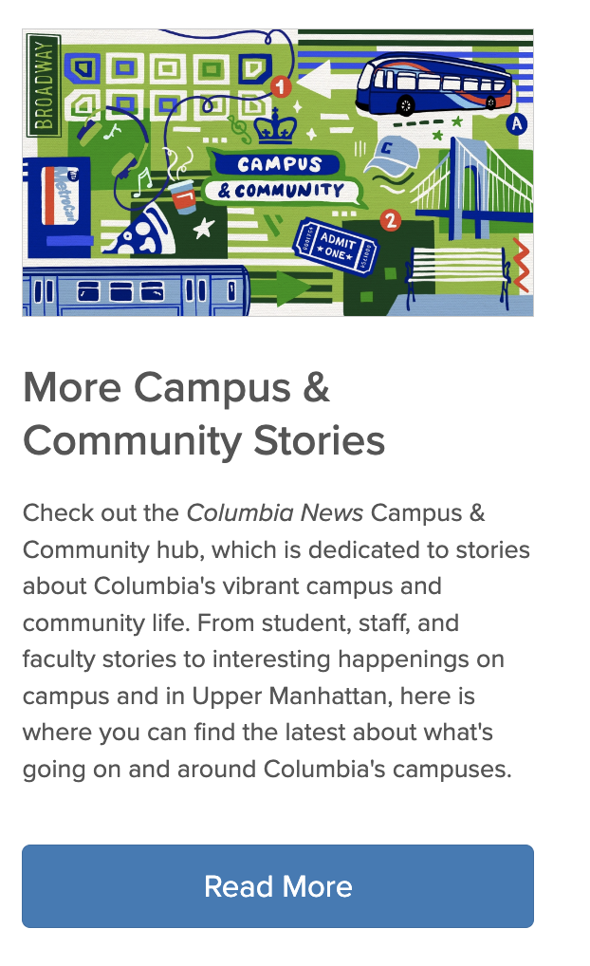
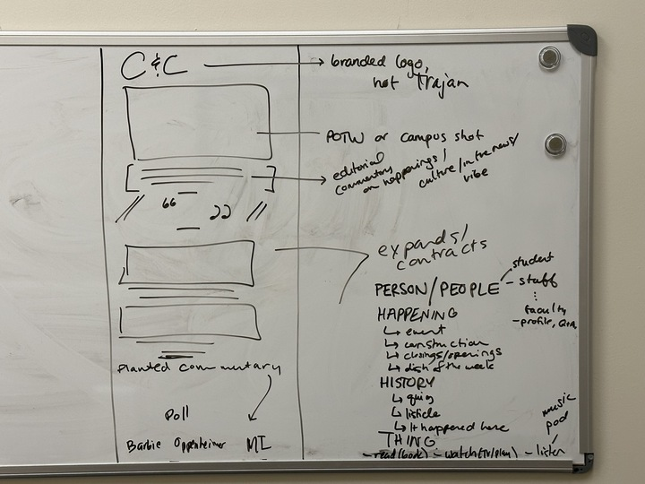
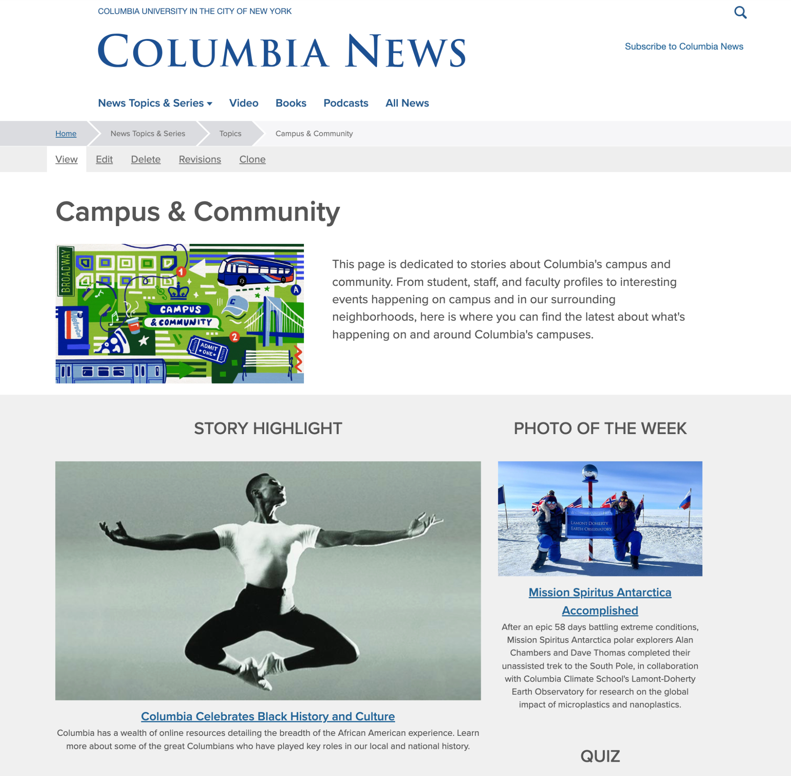
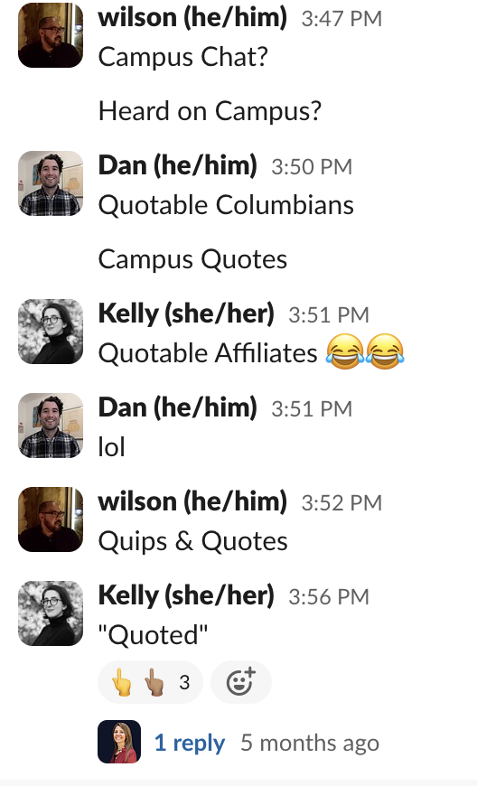
Iterating Campus & Community
What We Knew
What We Brainstormed
What We Designed
How It Is Going
😔
Underperforming newsletter
🤔
Highest opens & click-throughs on:
Commencement
History-Based
Columbian Accomplishment
Photo-Driven Subject Lines and Stories
“Coming Together”
10%
open rate
🥳
We Could Produce/Partners Already Producing Content to Back This Up

Slide 6
What We Are Looking For
STORIES & CONTENT ABOUT…
DATE PEGS AND THEMES…
Research Breakthroughs
People Profiles, Undersung
Campus History, Lore, Etc.
People Coming Together, Collaborating
Recaps on Values Events
Heritage Month Connections (Black History, Women’s History, AAPI, Pride)
Staff Stories/Shout-Outs
Pi Day
Commencement
Notes:
Along with these broader content areas we will pay particular attention to the priority topics that Pres Shafik outlined, such as climate, AI, and mental health, lifelong learning and global and local engagement.

Slide 7
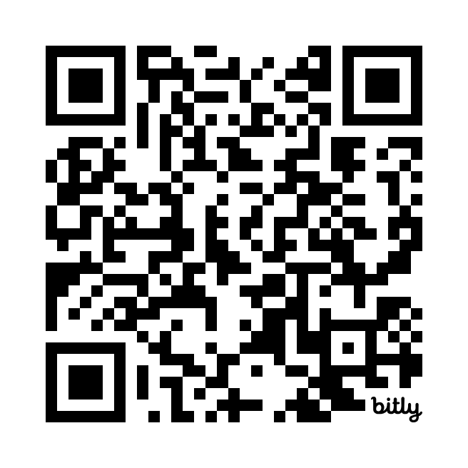
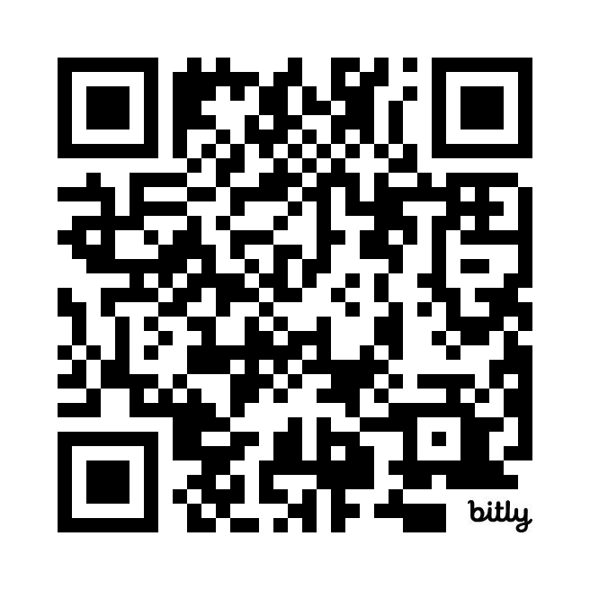
Share Your Content
Subscribe to Newsletters
Promotion Request Form
https://bit.ly/3StNHgZ
https://bit.ly/3vNBafq

